Slide 1
IPM and Pesticide Use
This IPM training program was developed by a partnership including the U.S. Department of Agriculture National Institute of Food and Agriculture, the U.S. Department of Housing and Urban Development, the U.S. Environmental Protection Agency, Centers for Disease Control and Prevention, the Pennsylvania IPM Program, the National Pest Management Association, the National Center for Healthy Housing, and the Regional IPM Centers.
Funding was provide by EPA, HUD, CDC, and USDA-NIFA.
The materials contained herein present a research-based, balanced, and objective approach to pest management in affordable housing and are intended to be used in their entirety. Any nonobjective or partial use of the materials is not recommended. Products, vendors, or commercial services mentioned or pictured in the trainings or presentations are for illustrative purposes only and are not meant to be endorsements.

Slide 2
Outline
HUDs Guidance on IPM
IPM in Practice
Pesticides
Notes:
2
Rev. 7/2014 Ver. 7/2014
This presentation describes IPM and pesticide use.
This an outline of the presentation.

Slide 3

Healthy Homes & IPM
To reduce housing-based health hazards, “keep it”:
Dry
Clean
Safe
Ventilated
Contaminant-free
Maintained
Thermally-controlled
Pest-free
Notes:
Give the larger context of IPM: These are the 8 Keep-its used by the National Center for Healthy Housing, HUD and others.
Protecting and maintaining a building for pest control will help make a building healthy to live and work in.
Keeping a home pest –free ties in with several of the other principles, or keep-its. Fewer pests mean fewer pesticides (contaminants), cleaning as part of IPM is “clean”, many of the recommended maintenance actions in IPM protect the home in other ways (fixing leaks).

Slide 4
What does HUD say about pest control?
Real Estate Assessment Center (REAC)
Deficiency: Evidence of rats, mice, cockroaches (droppings, holes)
Infestation: Live roaches, mice or rats; more than one dead roach
Uniform Physical Condition Standards—for project-based Section 8 properties
Housing Choice Vouchers: Housing Quality Standards (HQS)
If you are not familiar with these, look them up at HUD.gov
Notes:
4
USE THIS SLIDE FOR NON PUBLIC and INDIAN HOUSING In an effort to get trainees to see the big picture of how IPM is supported by HUD, this section has been added. HUD has a commitment to IPM and supports its implementation by funding programs like this training and inspecting for pest infestation.
HUD’s promoting IPM complies with Federal Insecticide, Fungicide, and Rodenticide Act: “Federal agencies shall use Integrated Pest Management techniques in carrying out pest management activities and shall promote Integrated Pest Management through procurement and regulatory policies, and other activities.” 7 USC 136r-1
The HQS applies to Section 8 Housing Choice Voucher properties. Public housing also uses it as a guide.
There are the key provisions of HUD’s Housing Quality Standards that relate to pests.

Slide 5
What does HUD say about pest control?
Real Estate Assessment Center (REAC)
Deficiency: Evidence of rats, mice, cockroaches (droppings, holes)
Infestation: Live roaches, mice or rats; more than one dead roach
Promotion of Integrated Pest Management
(NOTICE: PIH 2011-22) “IPM efforts must involve PHA staff, contractors, residents, and include:….. Establishing an ongoing monitoring and record keeping system for regular sampling and assessment of pests, surveillance techniques, and remedial actions taken, include establishing the assessment criteria for program effectiveness.”
Guidelines on Bed Bug Control and Prevention in Public Housing (NOTICE: PIH-2012-17) ”Within 24 hours of the tenant report, the PHA should make contact with the tenant, provide the tenant with information about control and prevention of bed bugs and discuss measures the tenant may be able to take in the unit before the inspection is performed. [Inspection should take place] within three business days of tenant complaint.” PHA may not charge tenant.
If you are not familiar with these, look them up at HUD.gov
Notes:
5
USE THIS SLIDE FOR PUBLIC AND INDIAN HOUSING In an effort to get trainees to see the big picture of how IPM is supported by HUD, this section has been added. HUD has a commitment to IPM and supports its implementation by funding programs like this training and inspecting for pest infestation.
HUD’s promoting IPM complies with Federal Insecticide, Fungicide, and Rodenticide Act: “Federal agencies shall use Integrated Pest Management techniques in carrying out pest management activities and shall promote Integrated Pest Management through procurement and regulatory policies, and other activities.” 7 USC 136r-1
The HQS applies to Section 8 Housing Choice Voucher properties. Public housing also uses it as a guide.
There are the key provisions of HUD’s Housing Quality Standards that relate to pests.

Slide 6
Typical local housing codes say:
Structures shall be kept free from insect and rodent infestation
Structures in which insects or rodents are found shall be promptly managed by approved processes that will not be injurious to human health
Proper precautions shall be taken to prevent re-infestation
Some cities and municipalities now have laws regarding bed bugs. Know the laws in your community.
Notes:
6
The community may have a local housing or sanitation code that addresses pest management. These codes typically apply to public housing. The code that is the most stringent must be met.
Suggestion: Customize the training by obtaining copies of local housing codes.

Slide 7
IPM does more than control pests
Fixing pest entrances helps to weatherize buildings and keep them dry
Monitoring for pests allows for early intervention before the problem gets out of hand
Educating residents empowers them to improve their housekeeping skills
When people learn that they can do something to improve their living conditions, expectations for pest control will rise!
Notes:
7

Slide 8
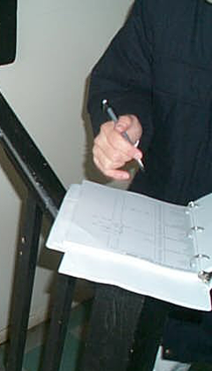
IPM in practice:
Documentation is key
One IPM log in each building
Record:
date
detailed observations
action taken
Make sure action is taken promptly
Notes:
An IPM log is one of the most essential pest control tools. Collecting and sharing facts is important to everyone on the IPM team.
Recordkeeping in ONE building log or online system will help make sure everyone’s observations are noted and followed up on. Having all observations in one place helps identify trends and “focus units.” A focus unit has the highest level of infestation in an area (based on sticky trap counts).

Slide 9
What’s in the IPM log?
Focus unit tracking sheet
Service schedule
Service log
Applicator licenses
Proof of insurance and business registration
Contract/service agreement
Potential notifications/ preparation instructions
Product labels and Safety Data Sheets (SDS) for all pesticides
Educational materials for staff and residents
Notes:
Reviewing the IPM log will reveal patterns. It will also show the PMP the nature and location of problems so that he or she can respond. The log is the place to track improving sanitation, fixing a water leak, caulking a crack, placing bait, or applying a least risky pesticide. IPM-related information collected during HUD inspections should be transferred to the IPM log.
Examples of log entries: where traps and bait stations are placed; notes about resident cooperation to be followed up on by resident services; notes about needed repairs (work orders will need to be filed too) that will be followed up on by maintenance staff. A log book helps communication between maintenance staff and the PMP, as well as between maintenance workers at shift changes. One system for all members of the housing community will avoid confusion and having all information in one place will make it easier to identify patterns and get to the source of the problem.

Slide 10
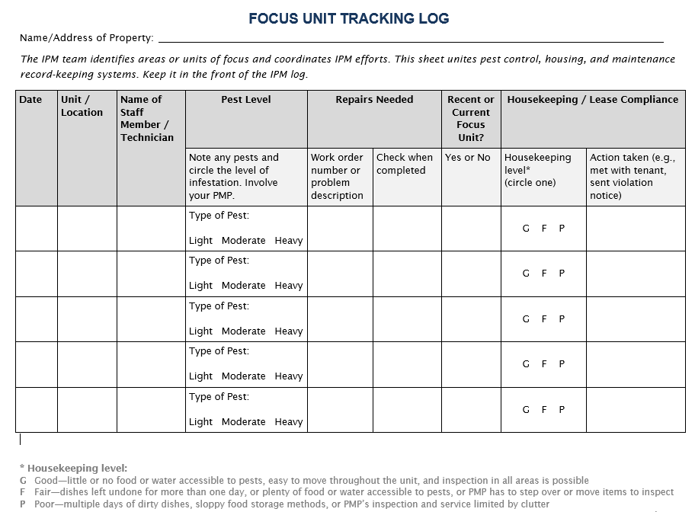
Find this log at stoppests.org
Notes:
Are these in the handouts?
Ask students to find their handout. Discuss how tracking focus units involves multiple departments (pest control, maintenance, resident support, etc).
Tie this back into the holistic, or coordinated overall approach of IPM that unites sanitation, exclusion, repair and controlled chemical use.
This is available in Excel on Stoppests website

Slide 11

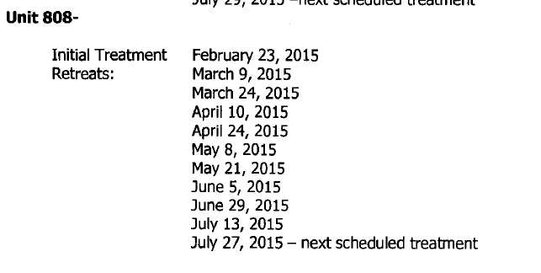
Recordkeeping is useless unless the records are reviewed periodically
Notes:
Targeting relief program will target chronic relief.
SLA service level average – track how quickly we get to work orders. Might go up because it will take longer. This will affect SLAs at first

Slide 12
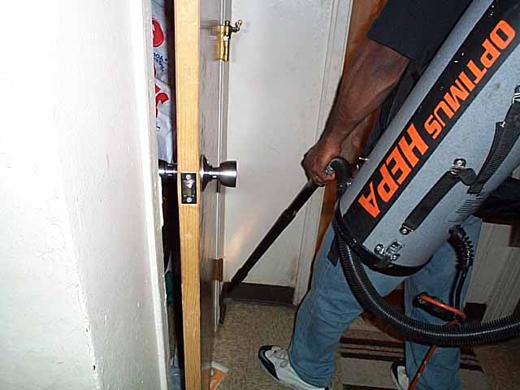
At first more work, but then less
More education, repairs, and monitoring
Increased work orders
  Pests and pest-friendly conditions that were previously overlooked are reported
THEN…
Fewer
complaints
Fewer pests
A better place to live
Notes:
12
The Boston Housing Authority states that at the beginning of their IPM program a lot of work was requested because unreported problems were finally reported. As the repairs were made and pests were controlled, there were fewer work orders than before the IPM program.
IPM is not something that can work when implemented half-heartedly.

Slide 13
Another view
Invest
  time and materials for repair and education
Protect
  through exclusion, sanitation, and careful
  product choice based on least risk to human health and the environment and compatibility with other management practices
Maintain
  with monitoring, communication, and documentation so that infestations do not grow
Notes:
13
Property management will have to invest time and money to get caught up on repairs, but these repairs are essential to IPM and protecting the building from the damaging effects of moisture.
Once fixed, the building must be maintained.
Pest management will be an everyday event because preventative measures will be taken so that pest levels stay very low.

Slide 14
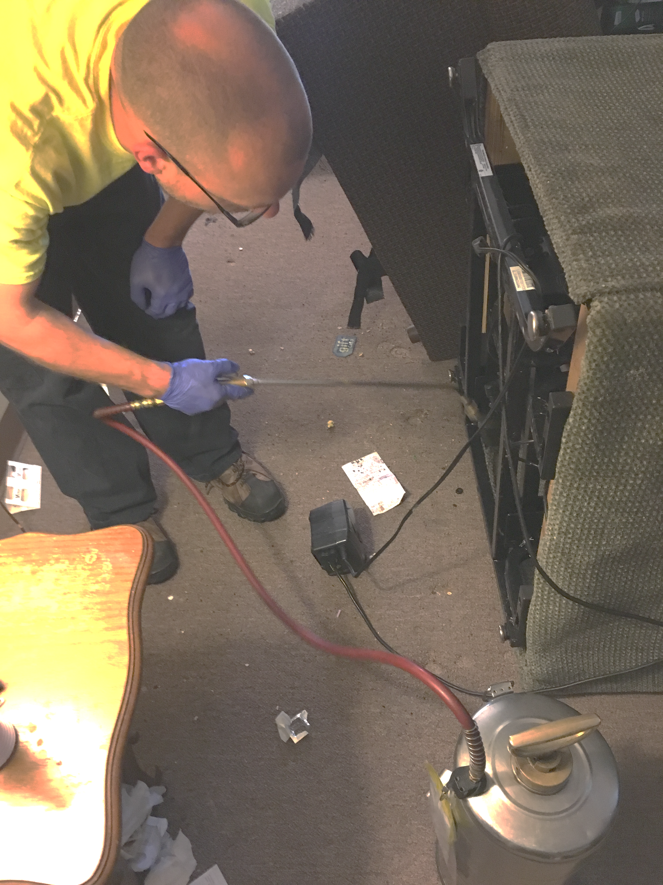

Pesticides
Any substance or mixture of substances intended for:
  preventing
  destroying
  repelling or
  mitigating
…any pest
Pesticides should be applied only by a licensed PMP*
The label is the law
EPA does not assess effectiveness, only risk/benefit when used in accordance with the label
Notes:
Pesticides should be applied only by a licensed PMP.
The exception: Residents may use tamper resistant stations containing bait
With an IPM program in place, almost all infestations can be managed with a pesticide that says, "CAUTION" on the label.
The EPA takes great care to review the uses of pesticides to avoid impacts to people or the environment. But EPA assumes that people will follow the pesticide label. Read the label carefully!
DANGER means that the pesticide product is highly toxic by at least one route of exposure. It may be corrosive, causing irreversible damage to the skin or eyes. Alternatively, it may be highly toxic if eaten, absorbed through the skin, or inhaled. If this is the case, then the word “POISON” must also be included in red letters on the front panel of the product label.
Labels list locations where the chemical can be legally applied. Labels are the law.
Labels tell you how the product must be used. The following unapproved or “off-label” uses are not only dangerous, they’re illegal:
using higher (stronger) concentrations;
using the pesticide in places not listed or against pests not listed;
not using proper protective equipment;
unapproved application techniques; or
improper disposal.

Slide 15

Concerns with pesticides
Pests become tolerant of or avoid pesticides
Risk from exposure may outweigh the benefit
Possible harm to pets and wildlife
Certain populations may be especially vulnerable or sensitive to some pesticides:
  Elderly, children, pregnant women
  People with breathing or lung disorders such as asthma
  People with chemical sensitivities
Notes:
15
Refer back to the discussion at the beginning of the day about previous practices and their effectiveness.
Avoid disparaging pesticides. Put them in context. Pest management using only routine spraying of pesticides is akin to farming cockroaches. The building supplies food, water, and shelter for cockroaches to thrive in, and once a month some are harvested (killed by pesticides). As long as food, water, and shelter are present, the cockroaches will be there too. Pesticides work to kill most of the time, but they do not solve the ongoing problem and may pose unnecessary risk.
Some of the trainees may have experience with resistance (pests don’t die) or aversion (pests avoid baits).
Property managers and maintenance crews must identify residents who are especially vulnerable to chemical exposure. Some residents may not be able to tolerate the presence of chemicals, such as gel baits, in their units, or they may feel that admitting a PMP to their unit may expose them to the pesticides present on the PMP’s clothing. Special attention must be given to people with chemical sensitivities so that they receive pest management services that meet their needs. Conventional pesticides should not be used in the units occupied by people with chemical sensitivities, or in adjacent or neighboring units, or in common areas such as the halls, lobbies, laundry rooms, elevators, or stairs, or along paths of travel for disability access. (Under the Fair Housing Act, chemical sensitivities can constitute a handicap. Multiple Chemical Sensitivities (MCS) refers to a condition that causes a person to have severe hypersensitive reactions to a number of different common substances including pesticides and solvents.) People with chemical sensitivities are frequently very knowledgeable about least risky pest control practices and may be helpful in assisting and educating other tenants in achieving the IPM goals. The elderly, pregnant women, and families with children are at greater risk for adverse health effects associated with exposure to pesticides. For these reasons it makes sense to use reduced risk practices, to follow label instructions, and to practice prevention-based approaches that reduce reliance on chemical control measures. Working with these residents is an important part of the property manager’s responsibilities.

Slide 16
Why do people tolerate exposure to pests and pesticides?
Accustomed to living with problems
Low standards for pest control and maintenance
Other priorities
Not aware of the problems
Cannot envision a better way
Notes:
16
There is a better way to manage pests than just using conventional pesticides.
Suggestion: Ask the trainees why they think people tolerate pests.

Slide 17
Pesticide risk
Notes:
The risk associated with a pesticide is determined by both the toxicity of the chemicals and the risk of exposure to the product.

Slide 18
Pesticide risk of exposure by application method
Less risk of exposure
More risk of exposure
Tamper- resistant station
Gel bait
in a crevice
Total release fogger
Notes:
Risk of exposure is the risk of coming in contact with a pesticide. Note that touching a pesticide that can be seen is not the only way to be exposed to pesticides. Get trainees to think about pesticides getting into the air and remaining on surfaces even when they can’t be seen or smelled.
Another risk to consider is that someone could misuse a pesticide by applying it incorrectly.
Suggestion: Have trainees think of and place on the gradient one or two other application methods they have seen.

Slide 19
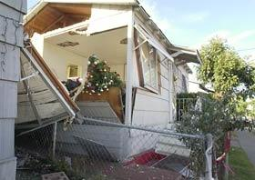
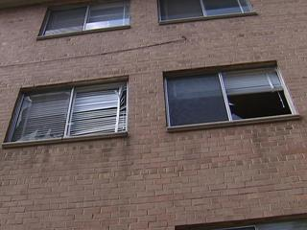
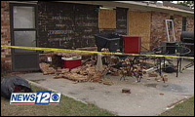
Total release foggers aka “bug bombs”
San Diego, CA, July 1992
Chemicals fail to reach places where cockroaches congregate the most
Leave behind nasty toxic residue in… areas cockroaches generally avoid but which are heavily used by humans and pets
Washington, DC,
August 2008
Augusta, GA, March 2008
Notes:
19
The photos above show houses and apartments destroyed by “bug bombs” used incorrectly.
Foggers, officially called “total release foggers” (TRF), release a very fine mist of pesticides into the air from pressurized cans. The mist penetrates deeper than a liquid spray. They pose the same risk of exposure as sprays. In the hands of a consumer they are prone to dangerous misuse. The propellant (isobutane or isopropane) that spreads the insecticide through the air is flammable and can create an explosion. Foggers will cover all surfaces, regardless of whether they need pesticide. Foggers may also affect pets.
Total release foggers, commonly known as “bug bombs,” are ineffective at removing cockroaches from indoor environments, according to a new study from North Carolina State University.
Bug-bomb chemicals fail to reach places where cockroaches congregate the most – on the underside of surfaces and inside cabinets, NC State researchers say. Besides leaving behind numerous cockroaches, bug bombs also leave behind nasty toxic residue in the middle of floors and countertops, areas cockroaches generally avoid but which are heavily used by humans and pets.

Slide 20
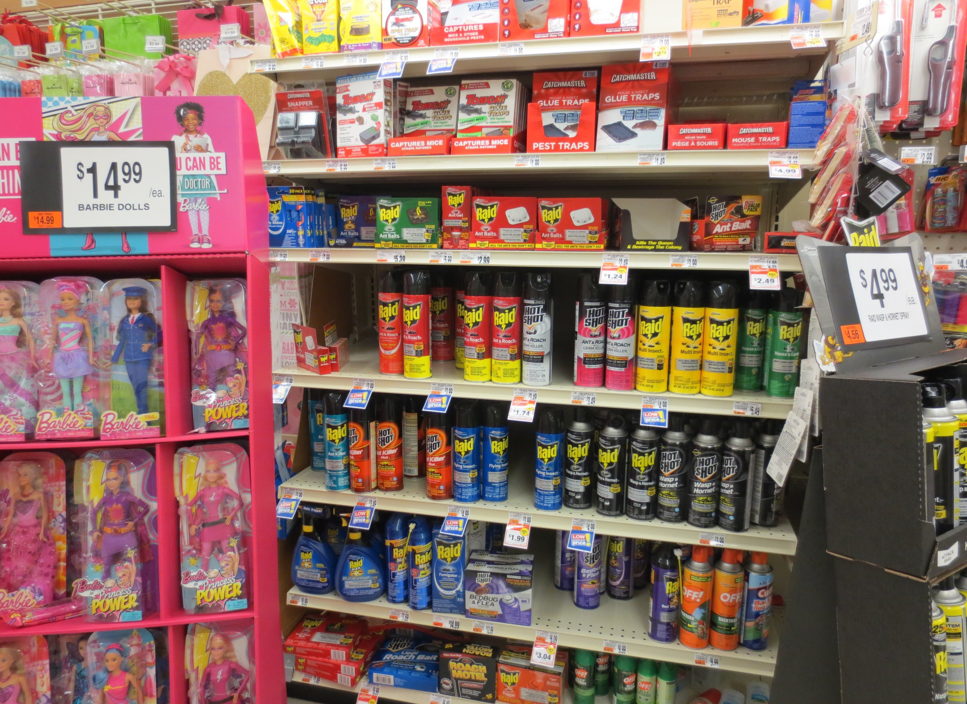
Notes:
Just because they’re available in any grocery store does not mean they’re safe. Or even effective.
This photo was taken in the grocery store – right next to the gift wrap and the Barbie display.

Slide 21
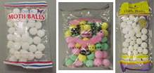
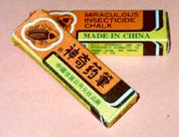
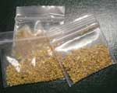
Illegal and risky pesticides
Unlabeled Mothballs
Chinese Chalk
Tres Pasitos
Products without an EPA label are illegal
Educate residents on the dangers
  Report illegal sales to the EPA or to the state pesticide licensing agency.
Notes:
Examples of illegal pesticides are pictured.
The three pictures on the left are of unlabeled packages of mothballs.
The fourth photo is Chinese Chalk. People illegally use this unregistered pesticide to kill cockroaches. But the “chalk” could seriously harm people, especially children and pets.
The fifth photo is Tres Pasitos—“three little steps” in Spanish. The phrase refers to the number of steps mice take before they die.
Insecticide “chalk” (a.k.a. Miraculous or Chinese Chalk) and Tres Pasitos are two common illegal pesticides sold by street vendors or at ethnic markets.
Pesticides are illegal when they are not registered by the EPA or the state within which they are used or they are used against the label. Illegal pesticides should not be purchased or used.
Illegal pesticides may be stronger than ones that are legal for residential use. People may be tempted to purchase and use illegal pesticides because they are fast-acting. These products are illegal and harmful to people and pets.
In Boston, there has been success with pesticide buy-backs where residents are paid for the pesticides they have in their home.
To find a pesticide licensing agency, use the map at http://npic.orst.edu/mlr.html.

Slide 22
Product use and emergencies
National Pesticide Information Center
800-858-7378
www.npic.orst.edu
Poison Control Center National Hotline
800-222-1222
www.aapcc.org
Notes:
NPIC can help answer questions when IPM teams are trying to choose compatible and effective treatments.
The Poison Control Hotline should be used in emergencies.
Labels also have emergency contact numbers on them.

Slide 23
Module review
(What will you do now?)
Who does what?
What’s in your contract?
Encourage reporting
  Pests
  Conditions (leaks, holes)
Turn PMP and resident observations into work orders
Discourage pesticide use by residents
Keep an IPM log
Evaluate effectiveness
Focus units schedule
Service schedule/log
Baits not sprays
Tools used other than sprays
Educational materials for residents

Slide 24
Questions?

